Slide 1
Playlist Management in a Music Streaming Application Using Doubly Linked List
CSA 0315 – Data Structures
Presented by:
K. Madhulika

Slide 2
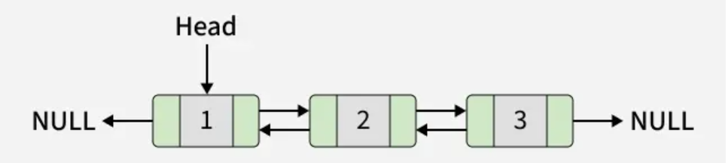
Introduction
Music streaming applications allow users to create and manage personalized playlists.
Users can add, remove, reorder, and play songs at any time.
Since playlists change frequently, an efficient and flexible data structure is required.
A Doubly Linked List is well suited for managing dynamic playlists because it supports easy insertion, deletion, and navigation.

Slide 3
Doubly Linked List
A Doubly Linked List is a linear dynamic data structure consisting of interconnected nodes.
Each node contains three fields: previous pointer, data, and next pointer.
It allows bidirectional traversal, enabling movement in both forward and backward directions.
Memory is allocated dynamically, allowing the list to grow or shrink during execution.
It is commonly used in applications such as music playlists, browser history, undo/redo operations, and navigation systems.

Slide 4
Operations
Traversal
Visit each song one by one for displaying or playing the playlist.
Starts from the head node and continues until null.
Searching
Find a song by its title, artist, or other attributes by traversing the list.
Insertion
Add a new song at the beginning, end, or
specific position.
Requires updating only the relevant link(s).
Deletion
Remove a song from the playlist.
Adjust the links to maintain the sequence.

Slide 5
Advantages
Advantages
Efficient insertion and deletion.
Easy navigation between previous and next nodes.
Dynamic memory allocation.
No need to shift elements during updates.
Suitable for playlist and browser history management.
Conclusion
Linked Lists provide efficient playlist management by enabling dynamic storage and easy modification of songs while maintaining their sequence.

Slide 6
Dictionary Word Search Using Hash Table

Slide 7
Introduction
A dictionary application stores a large collection of words along with their meanings.
Users expect search results to be displayed instantly after entering a word.
As the number of stored words increases, search efficiency becomes more important.
Choosing the appropriate data structure improves the speed and performance of the application.
A Hash Table is widely used because it provides fast word lookup.

Slide 8
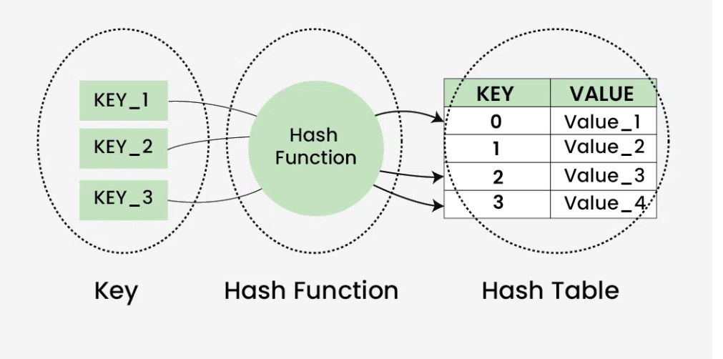
Hash Table
A Hash Table is a data structure that stores data as key–value pairs.
It uses a hash function to convert a key (word) into an index.
The word is stored at the calculated index for quick retrieval.
Searching is performed by calculating the same hash value and checking the corresponding location.
Average search time complexity is O(1).

Slide 9
Operations
Insertion
A word (key) is processed using a hash function.
The generated hash value determines the index where the word is stored.
Searching
The input word is passed through the same hash function.
The corresponding index is checked to determine whether the word exists.
Deletion
The word is located using the hash function and removed from the hash table.
The table is updated to maintain correct access.
Collision Handling
When two different words produce the same hash index, a collision occurs.
Common techniques:
Separate Chaining
Linear Probing

Slide 10
Advantages
Advantages
Very fast searching
Efficient insertion
Easy implementation
Suitable for dictionary and spell-check applications
Reduces search time compared to linear search
Conclusion
Hash Tables enable fast and efficient word lookup, making them the ideal choice for dictionary applications.

Slide 11
Task Scheduling System Using Priority Queue

Slide 12
Introduction
A task scheduling system manages multiple jobs that need to be executed.
Each task is assigned a priority level based on its importance.
Higher-priority tasks should be executed before lower-priority tasks.
The scheduling system requires a data structure that supports efficient insertion and quick retrieval of the highest-priority task.
A Priority Queue is the most suitable data structure for this purpose.

Slide 13
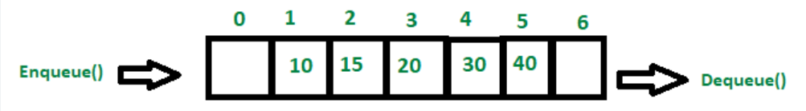
Priority Queue
A Priority Queue is a data structure in which each element has an associated priority.
Elements are removed based on priority, not on the order of insertion.
It is commonly implemented using a Heap (Binary Heap).
The highest-priority task is always available at the front of the queue.
Heap implementation provides efficient scheduling operations.

Slide 14
Operations
Insert (Enqueue)
Add a new task with its priority.
The heap rearranges to maintain priority order.
Time Complexity: O(log n)
Delete (Dequeue)
Removes the task with the highest priority.
Heap is reorganized after removal.
Time Complexity: O(log n)
Peek
Displays the highest-priority task without removing it.
Time Complexity: O(1)
Update Priority
Modify the priority of an existing task.
Heap adjusts to maintain the correct order.
Time Complexity: O(log n)

Slide 15
Advantages
Advantages
Fast execution of high-priority tasks.
Efficient insertion and deletion.
Improves overall scheduling performance.
Suitable for real-time applications.
Optimizes CPU and resource utilization.
Conclusion
A Priority Queue ensures efficient and reliable task scheduling by executing the highest-priority jobs first while maintaining optimal performance.

